Slide 1
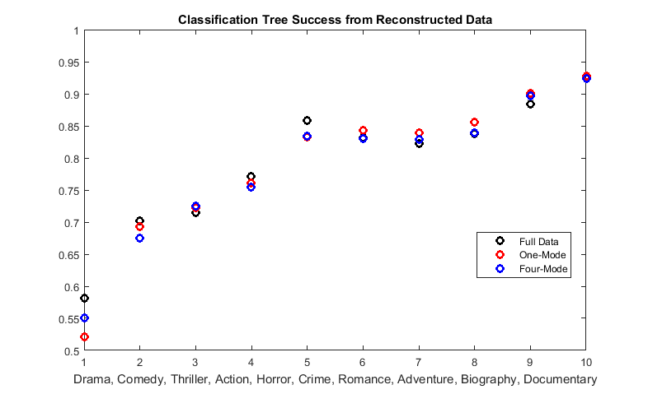
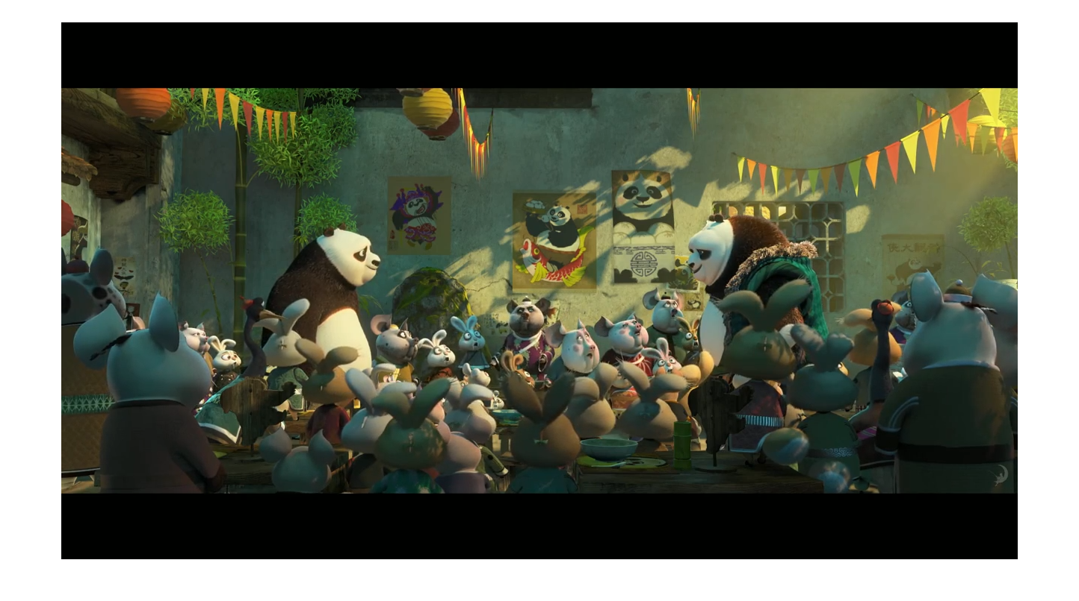
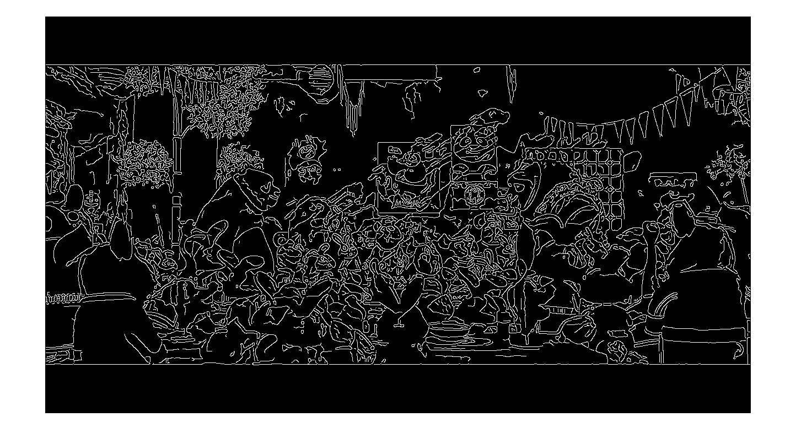
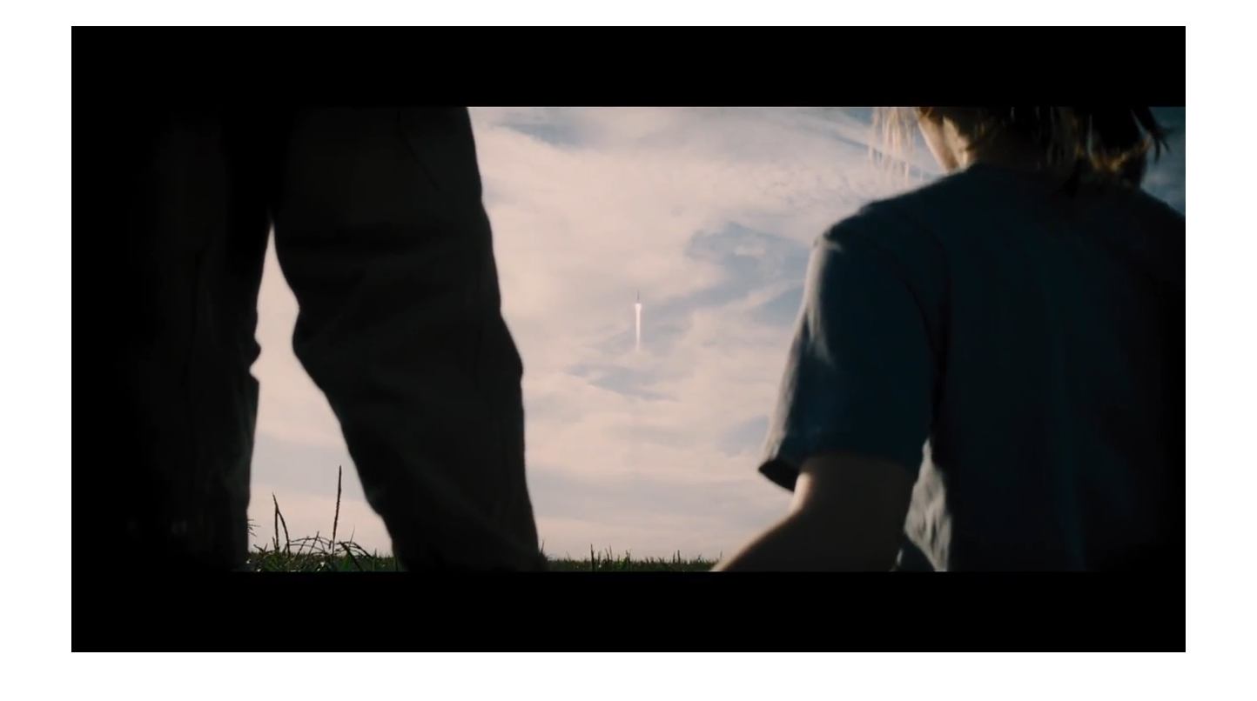
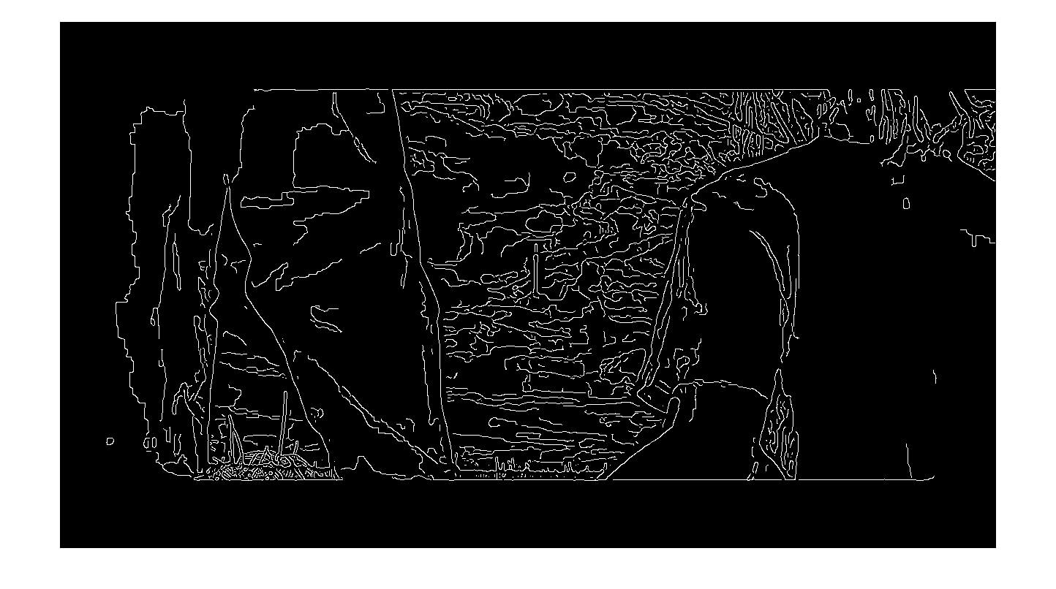
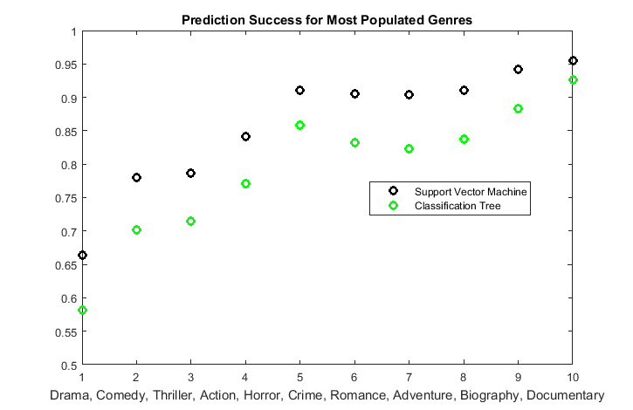
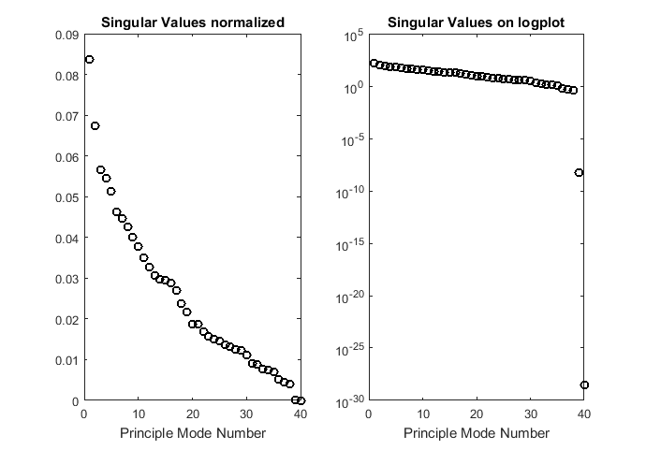
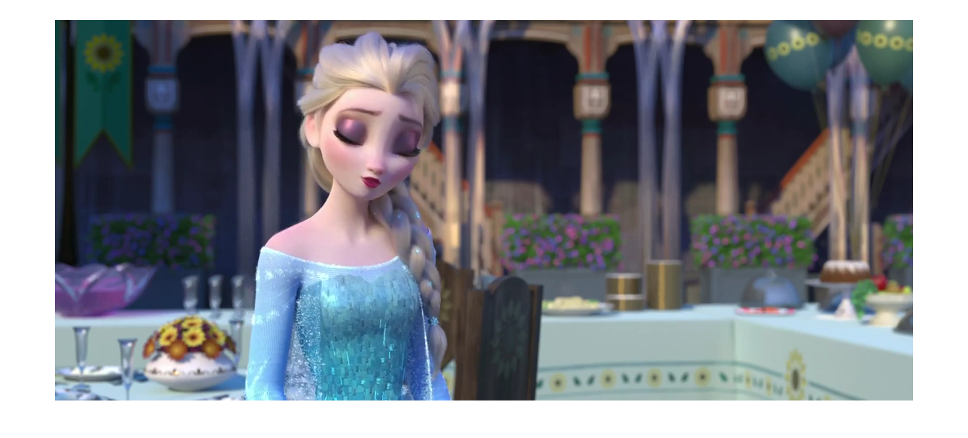
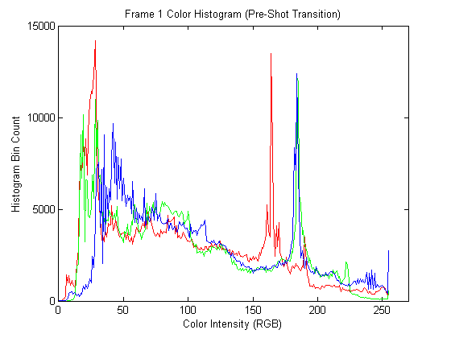
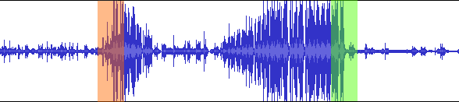
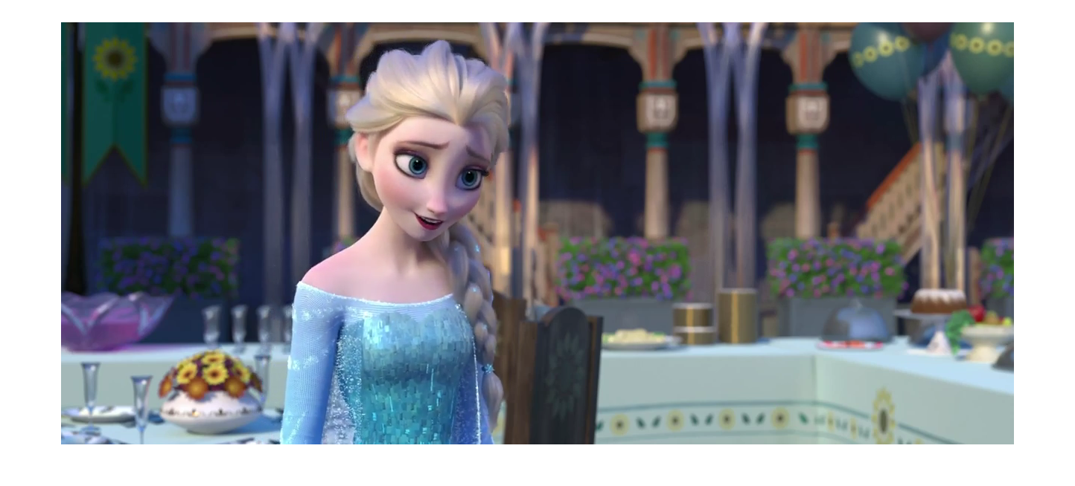

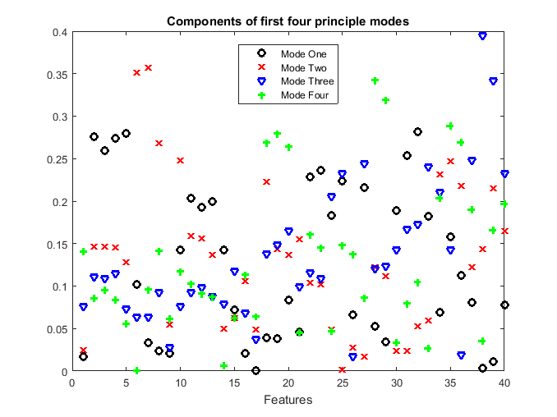
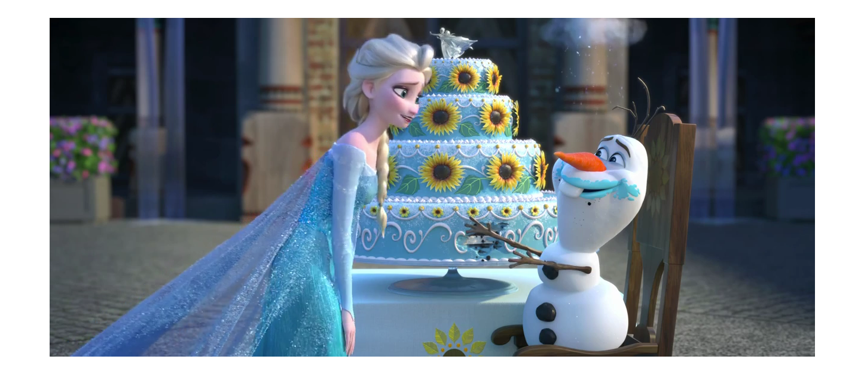
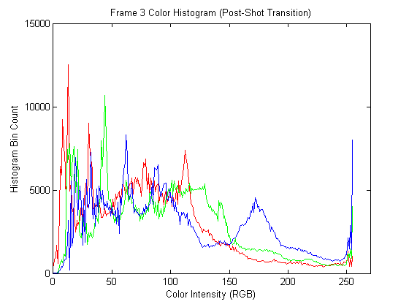
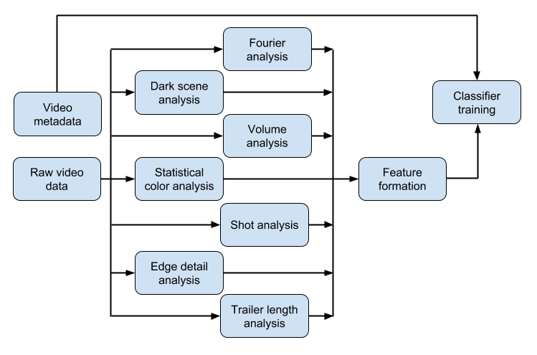
Multimedia Feature Generation of Movie Trailers for Genre Prediction
Nathaniel Guy, John Fuini and Yong Han Noel Kim
University of Washington, Computer Science & Engineering/Aeronautics & Astronautics
MOTIVATION
MOVIE FEATURE GENERATION (cont.)
APPROACH (cont.)
RESULTS
Movie trailers are one of the most effective advertising tools for movies. Human movie viewers can tell the genre of a movie given the first minute of watching its trailer. Viewers have developed this cognitive ability by watching countless movies of various genres over time, and have subconsciously associated certain cinematic features with certain genres.
We aimed to develop an algorithm that mimics this process for computers. There were two major parts to this endeavor. One, is the process of identifying cinematic features from a large set of trailers of known genre, and two, is training a machine learning algorithm to develop classification criteria based on these features and genre metadata.
Lastly, the generated classification criteria was tested on a set of trailers to assess the effectiveness of our approach.
VI. Detail Score
We used Canny edge detection filter [2] to find average detail per frame.
RESULTS
MOVIE FEATURE GENERATION
Video Features
A large part of our features were generated via computer vision analysis package: OpenCV2 written in Python [1].
I. Total run-time
CV2 can provide the frames per second (FPS) for a given trailer as well, and this allowed us to calculate the run-time of trailers in seconds.
II. Number of frames
OpenCV allows the processing of video data on a per-frame basis. Individually frames were counted, in order to get a total run-time of any given trailer in terms of frame count.
III. Number of shots
We detected shot transitions by examining the color histogram for each frame, and detecting a drastic change in color histogram.
Edge detection filter measuring different detail score for frames with different level of detail. (top) Kung Fu Panda, Animation-Comedy (bottom) Interstellar, Adventure.
CONCLUSIONS AND FUTURE WORK
VII. Dark Scenes
A “dark scene” was defined as consecutive frames with dark transitions. We measured average lengths of such scenes, standard deviation of length, min. and max. length, and the percentage of dark scene in a given trailer.
Audio Features
I. Volume
The mean, standard deviation, min. and max. volume features were acquired from the audio waveforms.
II. Sudden rise/fall
Sudden increase and decrease of were defined as change in volume in a small time period with a magnitude of change larger than the standard deviation of volume.
REFERENCES
III. Frequency components of audio
The frequencies residing in an audio track was analyzed via Fast Fourier Transform. They were bucketed into standard eleven octave bands, and the percentage of each octave in the given trailer was noted.
[1] OpenCV. Itseez. Web. 09 Mar. 2016. http://opencv.org/.
[2] Canny, J., A Computational Approach To Edge Detection, IEEE Trans. Pattern Analysis and Machine Intelligence, 8(6):679–698, 1986
MACHINE LEARNING ALGORITHM
ACKNOWLEDGEMENTS
A demonstration of shot transition detection. The histograms pertaining to the same shot (top, middle) share similar color histogram, while the one for a different shot (middle) display different color components. (Frozen, animation)
IV. Shot length
Once the shot transitions were identified, we could get statistics such as: average shot length, min. and max. shot length, and their standard deviations as well.
V. RGB Component
R, G and B components denote the proportion of red, green and blue colors for a given pixel. We calculated the average intensities along each of these color channels, across pixels and across all frames.

